Slide 1
Tutorial 8
Implement and functionally simulate Binary to Gray and Gray to Binary code conversion in Quartus tool using both schematic and VHDL coding.

Slide 2
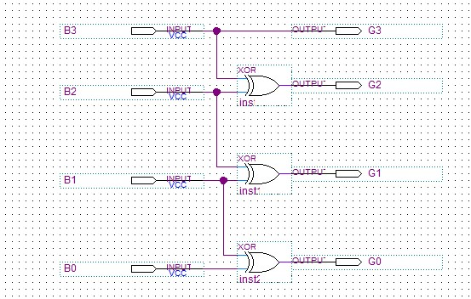
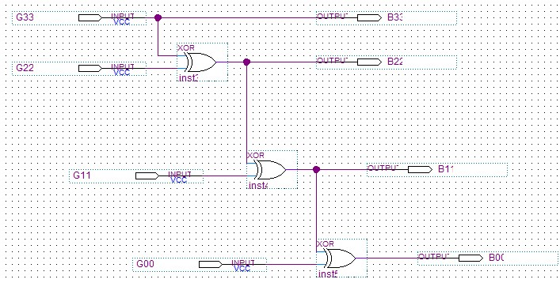
Schematic Design
Binary code to Gray Code
Gray Code to Binary code

